Slide 1
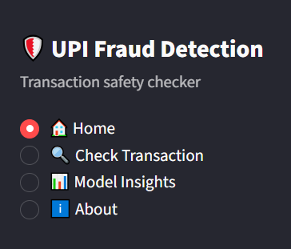
MINI PROJECT / AI & ML
UPI Fraud
Detection System
Machine Learning-Based Transaction Risk Analysis
Priya Sahani – 40
Aarushi Shah – 44
Amaan Shaikh – 48
Department: Artificial Intelligence & Machine Learning
College: Thakur College of Engineering & Technology (TCET)
A practical ML system that turns transaction signals into an interpretable fraud-risk decision.
01

Slide 2
01 / CONTEXT
01
What is UPI Fraud Detection?
The project sits between digital payments, data analysis and practical machine learning.
“Fast payments need
fast decisions.”
01
DIGITAL PAYMENT
A transaction is initiated through UPI.
02
RISK SIGNALS
Amount, user/device and transaction attributes create a behavioural profile.
UPI makes payments immediate. That same speed makes it important to identify unusual transaction behaviour quickly.
03
ML DECISION
The trained Random Forest estimates the likelihood of fraud.
04
ACTION
The interface converts that probability into a risk level and recommendation.
Core idea: automate the first layer of transaction-risk screening instead of relying only on manual verification.
02

Slide 3
02 / THE WHY
02
Problem Statement → Objectives
THE PROBLEM
THE OBJECTIVES
More digital transactions
= more data to verify.
01
Detect
Identify potentially fraudulent UPI transactions.
02
Score
Convert model probability into a Fraud Risk Score.
• Manual verification becomes slow at high transaction volumes.
• Fraud patterns can be difficult to identify consistently.
• A decision-support layer is needed before potential financial loss.
03
Classify
Group transactions into Low, Medium and High Risk.
04
Recommend
Give a practical next-step recommendation to the user.
The project is designed as a screening and decision-support system, not as a replacement for a bank’s full fraud investigation process.
03

Slide 4
03 / DATA
03
Dataset & Data Understanding
UPI Fraud Detection Dataset — the raw material behind the model.
26,393
65
4,545
21,848
RECORDS
COLUMNS
FRAUDULENT
GENUINE
WHAT THE DATA CAPTURES
DATASET SNAPSHOT
TRANSACTION
Amount, type, timing and transaction attributes
amount
type
merchant
is_fraud
USER / DEVICE
Behavioural and device-related information
₹ 2,450
P2M
Retail
0
UPI / MERCHANT
Merchant and payment-context information
Target variable
is_fraud → 0 = genuine | 1 = fraudulent
SECURITY
Verification and security-related attributes
Dataset figures used in this project: 26,393 rows and 65 columns; 4,545 fraud and 21,848 genuine transactions.
04

Slide 5
04 / PREPARATION
04
Data Preprocessing & Feature Selection
Before a model sees the data, the dataset has to be made usable — and safe.
01
02
03
04
05
RAW DATA
CLEAN
SELECT
ENCODE
MODEL INPUT
Inspect structure
and quality
Remove constant /
unusable fields
Keep relevant
transaction signals
Convert categorical
values for ML
Separate X
from target y
IMPORTANT DATA-LEAKAGE CHECK
Why?
Because a feature that directly or indirectly reflects the verification outcome can give the model information it would not have at genuine prediction time.
handle_verification_status was removed from the model inputs.
Preprocessing is not just formatting: feature selection also protects the model evaluation from misleading shortcuts.
05

Slide 6
05 / SYSTEM
05
Proposed Methodology
From a user-entered transaction to a practical risk decision.
01
02
03
04
05
06
07
USER INPUT
STREAMLIT
PREPROCESS
RANDOM FOREST
RISK SCORE
RISK LEVEL
RECOMMENDATION
Transaction details
Web interface
Prepare model features
Classify transaction
Fraud probability
Low / Medium / High
Action for user
10 CUSTOMER-FACING INPUTS
01 Transaction amount
02 Transaction type
03 Merchant category
04 Transaction timing
05 Location context
06 Device context
07 Network / connectivity
08 Payment context
09 User behaviour signal
10 Security / verification signal
The customer-facing layer is intentionally much simpler than the full 65-column training dataset.
06

Slide 7
06 / MODEL
06
Random Forest Classifier
An ensemble of decision trees used for binary fraud classification.
WHY RANDOM FOREST?
• Combines multiple decision trees rather than relying on one tree.
• Works well with mixed feature types after preprocessing.
• Can provide feature-importance information.
• Well suited to classification tasks such as fraud / genuine.
TREE 1
TREE 2
TREE 3
TREE N
ACCURACY
PRECISION
RECALL
F1-SCORE
ENSEMBLE DECISION
100%
100%
100%
100%
Interpretation: the reported test results were unusually perfect. This was treated as a dataset-specific signal, not proof of a perfect real-world model.
07

Slide 8
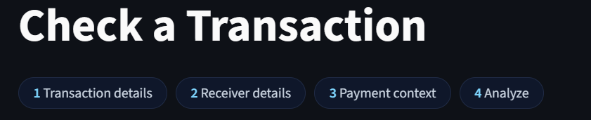
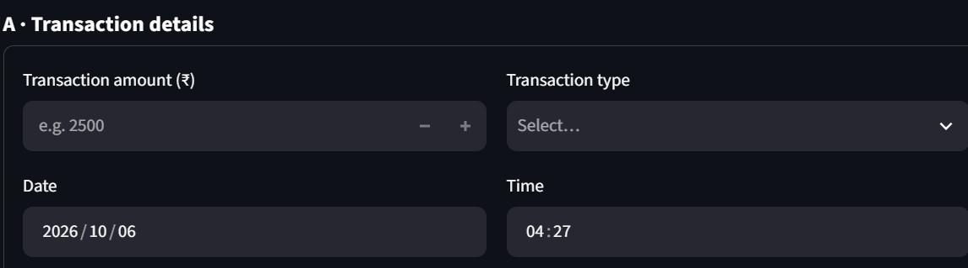
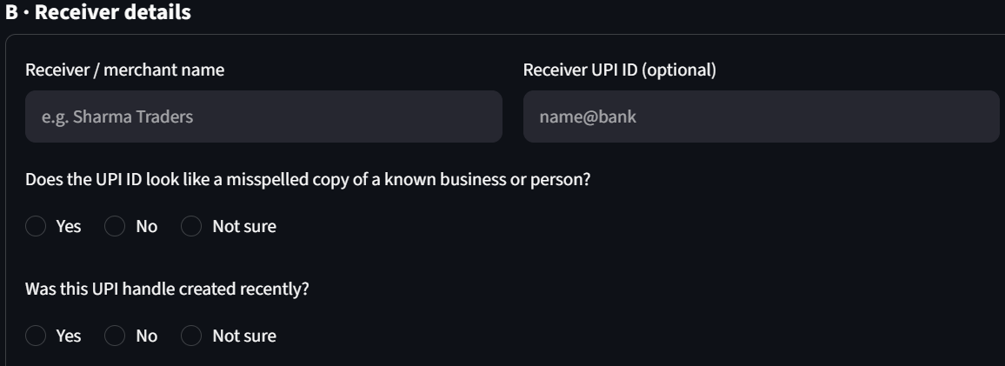
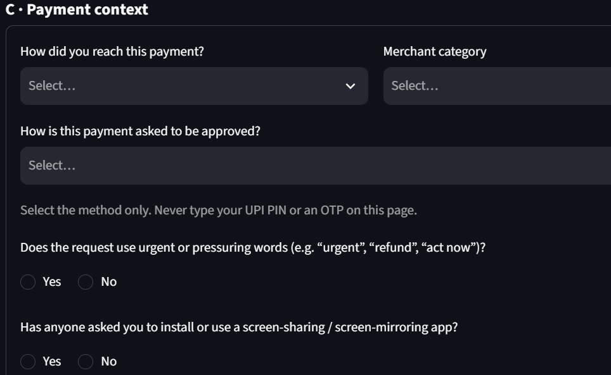
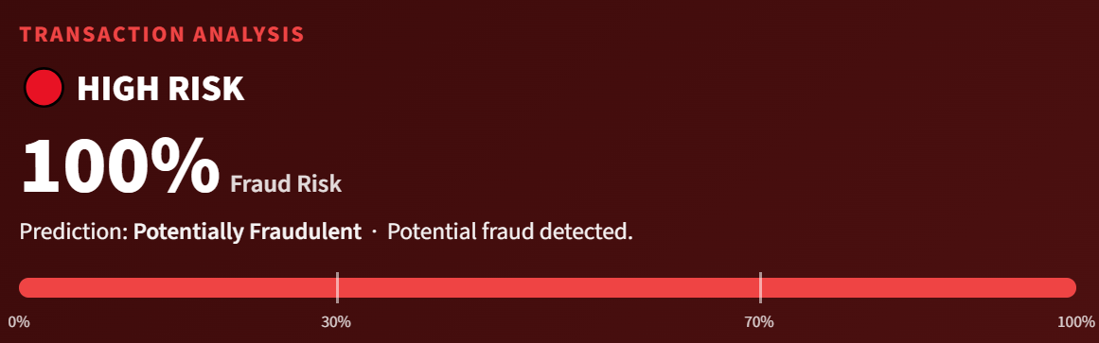
07 / PRODUCT
07
Web Application & Results
A Streamlit dashboard turns the model into something a user can actually interact with.
RESULT
UPI FRAUD DETECTION / STREAMLIT
Fraud Risk Score
Transaction Risk Check
HIGH
Risk classification
High Risk
Recommendation
Review transaction
before proceeding.
The dashboard is designed to communicate the model output in human terms: score → risk level → recommendation.
08

Slide 9
08 / EVALUATION
08
Advantages · Limitations · Future Scope
ADVANTAGES
LIMITATIONS
FUTURE SCOPE
• Easy-to-use web interface
• Automated fraud risk assessment
• Fast prediction
• Risk score is intuitive
• Machine-learning based classification
• Dataset may not represent all real-world UPI fraud
• Performance depends on data quality
• Some training features are not customer-visible
• Perfect test scores suggest dataset-specific patterns
• Real-time transaction monitoring
• Larger and more diverse datasets
• Continuous model retraining
• Integration with payment platforms
• Explainable AI for each prediction
The strongest next step is not “more complexity” — it is better data, realistic evaluation and explainable decisions.
A responsible fraud-detection system must be evaluated against realistic, leakage-free data before deployment.
09

Slide 10
END / MINI PROJECT
THANK
YOU
TRANSACTION → MODEL → RISK → ACTION
UPI Fraud Detection System
LOW
MEDIUM
HIGH
10

